Slide 1
Does Your Resume TELL YOUR VALUE STORY?
Why Your Audience Needs to KNow

Slide 2
Start with sTORIES
What do people BRAG about WHO you are?
Power of 5 Questionnaire - Top 5
Most end up with traits / talents NOT on their resume
What do people BRAG about WHAT you have done?
Power of 5 Questionnaire - Top 5
Most end up with items NOT on their resume
What type of work do you WANT to do?
Power of 5 Questionnaire - Top 5
This creates ‘transferable skills’ brainstorming ideas

Slide 3
Start with sTORIES
What are FIVE measurable outcomes you have achieved?
Think in terms of: Situation, Task, Action, Result (S.T.A.R.)
Can be from Work, Volunteer, Hobbies…
Resume Questionnaire
Recommendation Letters OR Recommendations on LinkedIN – Do you have any?
Great source of HIDDEN value propositions
Most end up w/ items NOT on current resume
Resume Questionnaire

Slide 4
The HABITS (and ISSUES)
What does your audience want?
don’t focus on you!
Sell yourself above the fold
don’t waste valuable resume real estate!
Highlight results, accomplishments with dollars, numbers and percentages
don’t speak only about responsibilities!
Scrub for errors and inconsistencies
no typos, oddities or falsehoods!
Avoid old-school resume items
references available, position of education, objective,+

Slide 5
1.1 what your audience VALUEs
OLD RESUME HABITS:
It’s all about me
Has an “Objective Statement”
Uses I, me, my language
Focuses on what I want
Lacks clear results
Full disclosure vs. good sales message

Slide 6
1.2 what your audience VALUES
THE SHIFT:
WIIFM – What’s in it for me?
By “me” I mean “them”
Answers the Question: What problem does this person solve for ME?
Avoid first person: I, me, my, we
Lead with a good ‘branding statement’ (speaks -how you are unique / what problem you solve => to them) instead of an objective (says what I want)
Remember this is a Sales Document!

Slide 7
2.1 Sell yourself above the fold
THE CHALLENGE:
Fold your resume like a newspaper at the 5 ½” mark
OR TOP ½ webpage / mobile device view
Wasted valuable real estate on your resume
Additional unnecessary information that pushes your BEST information lower
Fail to make it easy to read, especially early on
What do you think is the average attention span of a normal adult?

Slide 8
2.2 Sell yourself above the fold
BRAIN SCIENCE:
According to a study by Microsoft, the average human being now has an attention span of eight seconds. This is a sharp decrease from the average attention span of 12 seconds in the year 2000. (Jan 22, 2018)

Slide 9
2.4 Sell yourself above the fold
BRAIN SCIENCE ASIDE:
According to the same study - people now generally lose concentration after eight seconds – compared to the average attention span for the notoriously ill-focused goldfish which is nine seconds.
=> This is highlighting the effects of an increasingly digitalized lifestyle on the brain.

Slide 10
2.5 Sell yourself above the fold
BRAIN SCIENCE:
In its 2018 Eye-Tracking Study, Ladders Inc. says that the time recruiters spend on the initial screen of a resume is up from an average of only Six Seconds in 2012, but only by about a second.
➔ Today’s Recruiters skim resumes for an average of 7.4 seconds.
LINK:
https://www.hrdive.com/news/eye-tracking-study-shows-recruiters-look-at-resumes-for-7-seconds/541582/

Slide 11
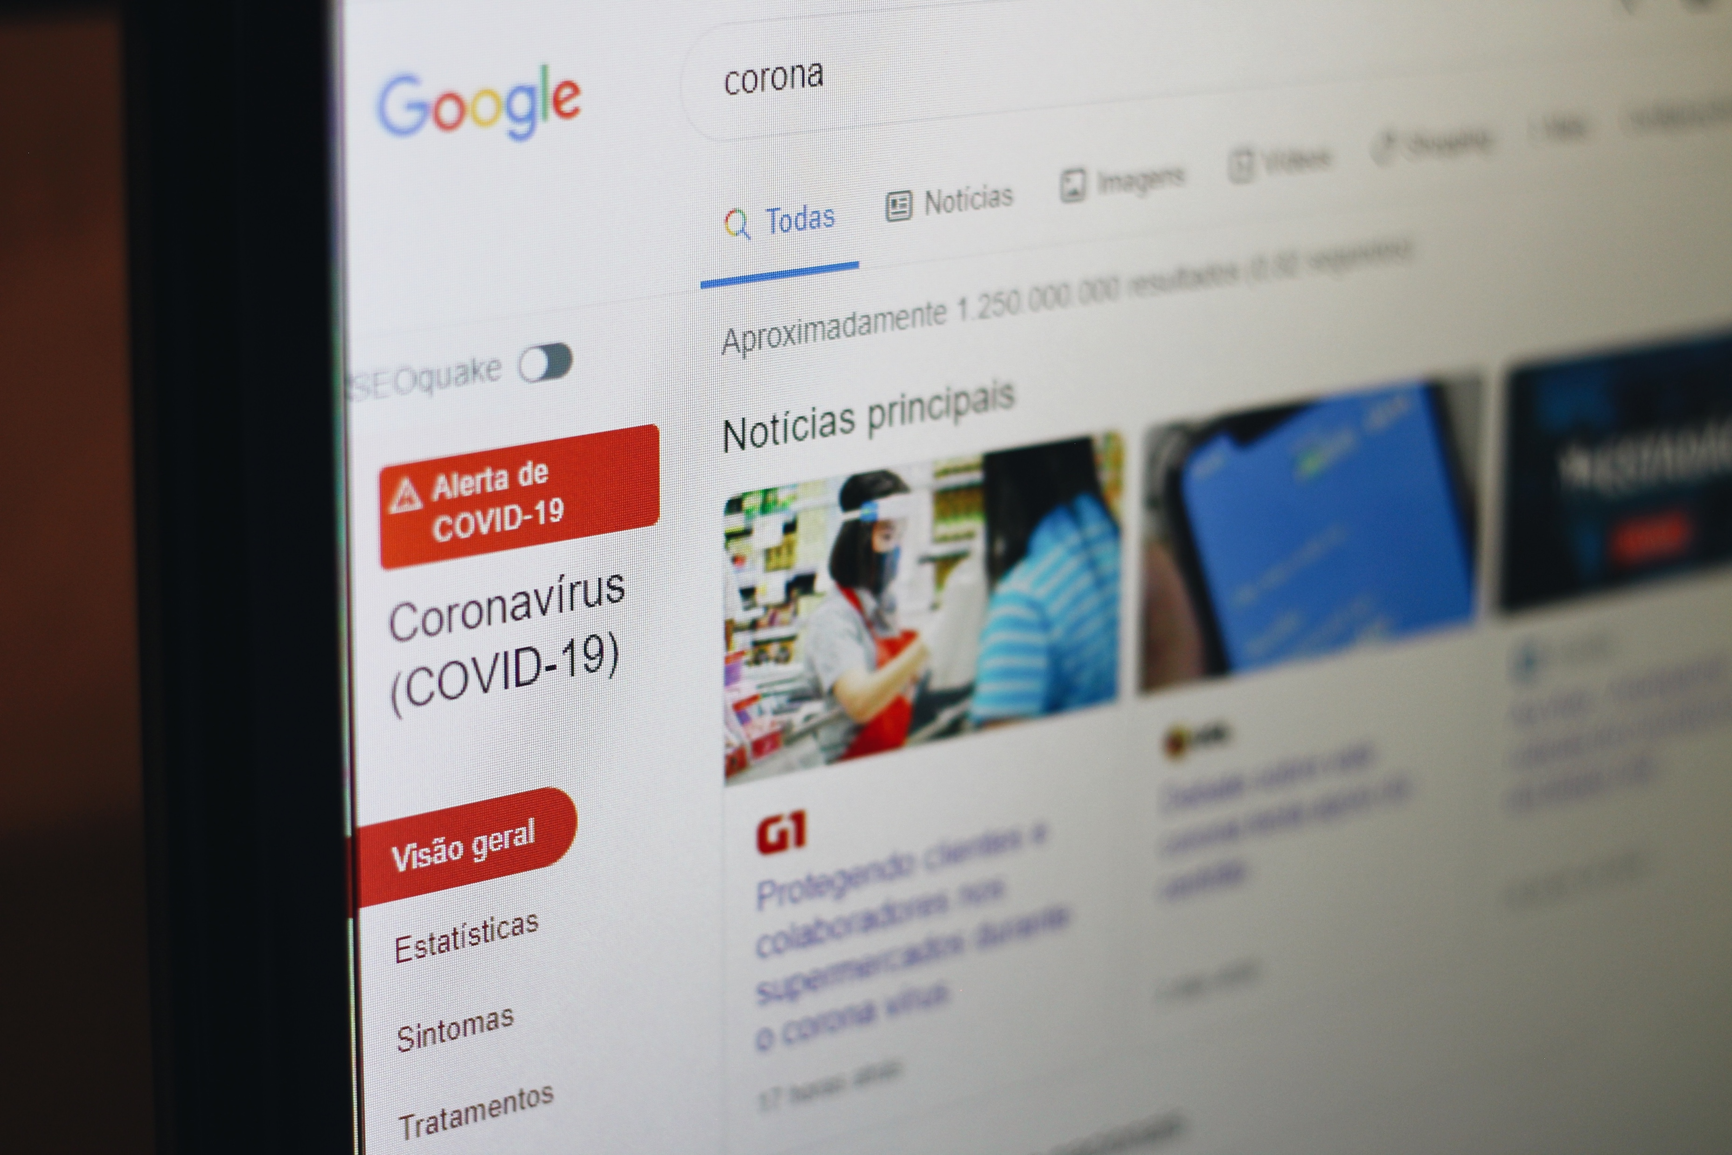
2.6 Sell yourself above the fold
BRAIN SCIENCE:
On the average Web page, users have time to read at most 28% of the Words during an average visit
=> 20% is more likely. (May 5, 2008)

Slide 12
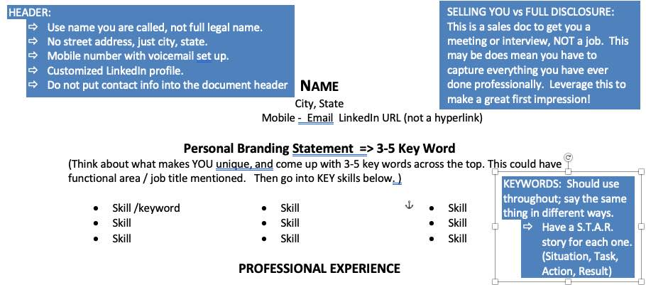
2.8 Sell yourself above the fold
THE FIX / WHAT DOES THIS MEAN TO YOU?
Get to the point
Be brief

Slide 13
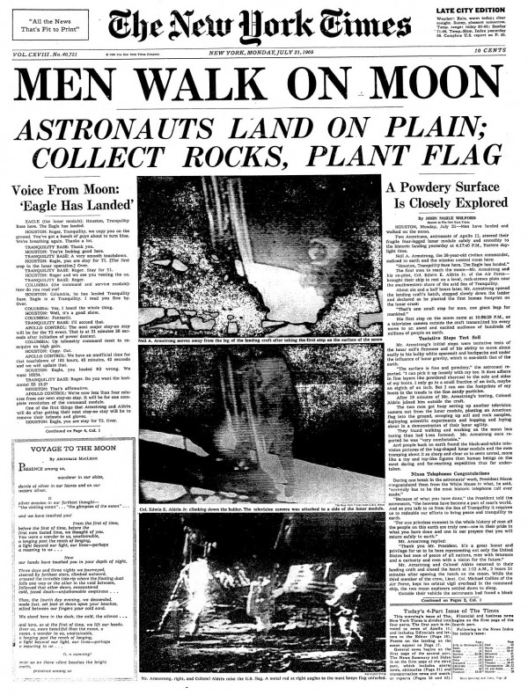
2.10 sell yourself above the fold
KEY: If you don’t catch their interest ABOVE the fold, they won’t read below it.

Slide 14
3.1 Highlight results with $, # & %
THE CHALLENGE:
Resume reads like a Job Description
Responsible for Sales
Manage the Revenue, JIB, Asset Management, Treasury, and Special Projects functions with a staff of 17 individuals (three supervisors, three seniors, 11 staff)
Incomplete equations; you only include one side (responsibilities) VERSUS what you accomplished when entrusted with those responsibilities

Slide 15
3.2 Highlight results with $, # & %
THE FIX:
If it’s worth saying on a resume, it’s worth including a result
What if I don’t have access to actual numbers or my work is difficult to quantify?
Ask a former supervisors, colleagues, customers, suppliers
Quote performance reviews
Calculate and estimate, aim low; if you figure you saved 25% based on just your calc., say 20% on resume; be ready to explain
LOGIC: If there is a REASON you improved something; you can QUANTIFY it.
Notes:
EXAMPLES:
Recruit for intern, entry level and administrative positions including screening candidates, facilitating the interview process and directing the offer process including making compensation recommendations.
Result: Completed recruiting process for more than 20 employees.
In first 3 months, identified and sold an additional service that increased company’s gross revenue by 1.3% or $360,000, which was a high-margin additional use of an existing service.
MORE EXAMPLES:
Directed and promoted wellness initiatives including voluntary team and individual challenges.
Result: Achieved 30-35% participation.
Negotiated a worldwide five-year software renewal contract with company's largest global client resulting in a $2.5M sale and a long-term contractual commitment for database purchases.
Increased output, $26M in 2011 to $37.5M in 2013. OTD, 82.3% to 92.66%. Past due, $1.72M to $160K.
Reduced scrap costs by $800k.

Slide 16
4.1 scrub for errors and inconsistencies
THE PROBLEM:
Minor typos
Major grammatical errors
Incorrect verb tense; lead vs. led
Inconsistent match between resume and LinkedIn profile, esp. dates of employment
Over-stating results
Complete lies – jobs that you never had
Education / degree not complete
Missing or incorrect contact information
Bullet inconsistency
Font inconsistency

Slide 17
4.2 Irregularities

Slide 18
4.3 scrub for errors
SURVEY DATA:
In 2009, Accountemps surveyed 150 senior executives from F1000 companies
Question: “How many resume typos does it take to decide not to consider a job candidate?”
One: 40%
Two: 36% ==>> 76% will toss you for just one or two!
Three 14%
Four+: 7%
How many are you willing to risk?

Slide 19
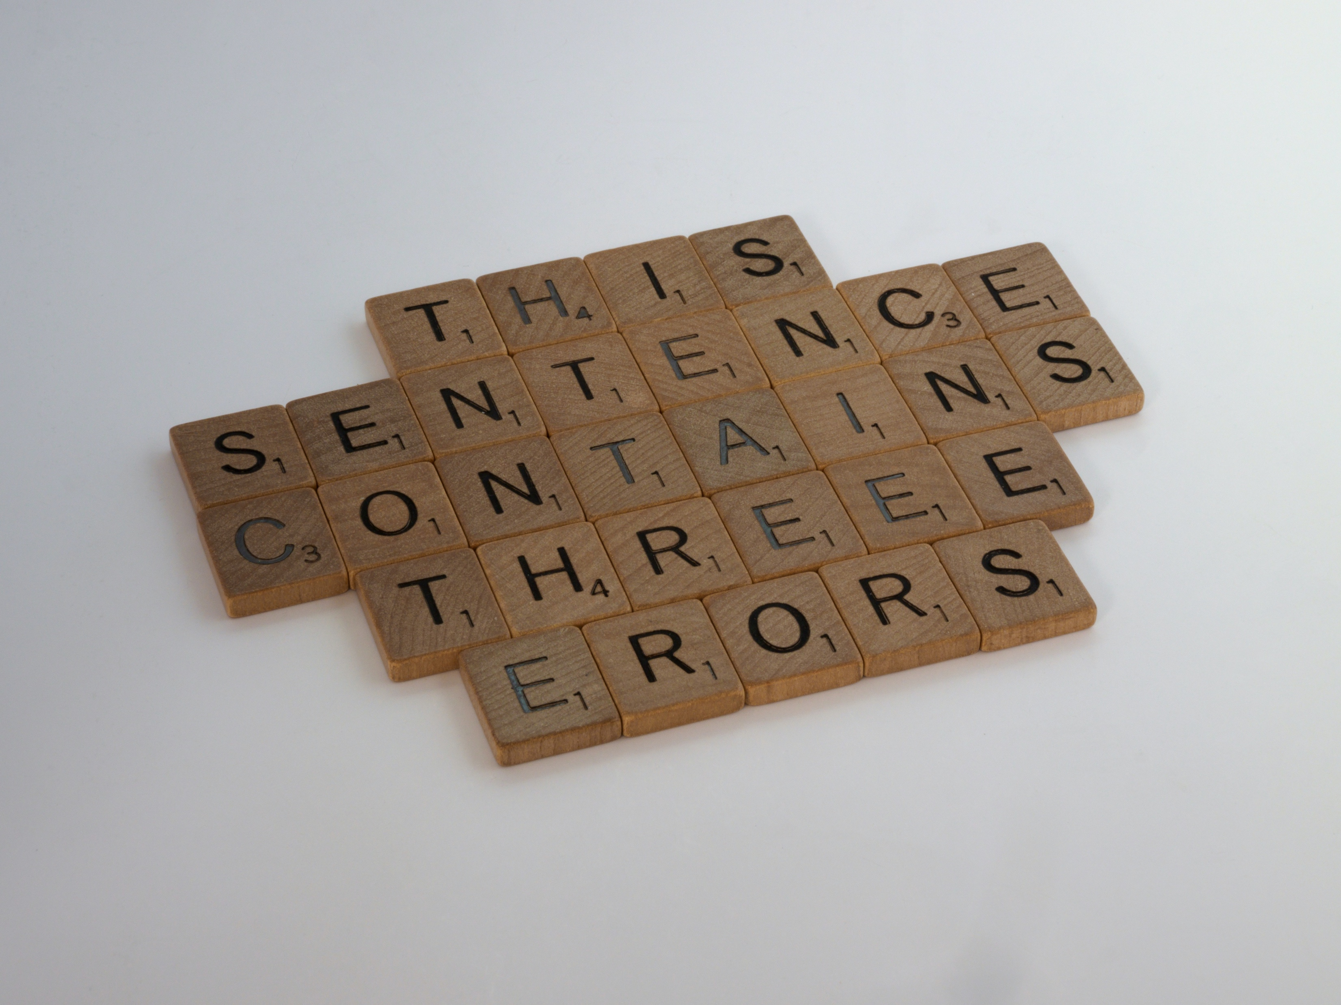
4.4 scrub for errors
COMMON MISTAKES:
Their / there
To / too
Some / sum
MS Excel / excel (the verb)
Spell check won’t catch these!

Slide 20
4.4 scrub for errors and inconsistencies
Typos, Errors:
Use spellcheck, but only as a first line of defense
Proofread it
Proofread it again the next day
Proofread by reading each word backwards / bottom up
Ask a meticulous friend/ family member to proofread it
Pay special attention to software names, acronyms, company names, school names, etc.
If your resume is sloppy, maybe your work is too!

Slide 21
5.1 Avoid old-school habits
THE PROBLEM:
Physical address
Objective
References available upon request
Written in 3rd person (as though someone else is speaking about you)
Resume saved as “resume1” or “resume-final”
Unprofessional sounding email
One page resume (for anyone other than a new grad)
Include personal information – married, kids, etc.

Slide 22
5.2 Avoid old-school habits
Street Address:
Limited address – Tulsa, OK 74135
Employers do not need your mailing address as part of the job search process
An employer could check your address using Zillow to determine your home worth and try to figure out if you can afford to take this job or could use it to adjust the offer.

Slide 23
5.3 Avoid old-school habits
Objectives:
Professional summary vs. objective
Objectives are taught to new grads (WHY? No Idea.)
They have no work history that defines their career
Objectives are about YOU, not them

Slide 24
5.4 Avoid old-school habits
Reference:
References are assumed; no need to mention
=>>> Have Ready in a separate document detailing relationship with each.
You may be tempted to include “references available upon request” because that’s been taught forever.
Note: If you don’t have references, you’re dead before you start. PREP THEM NOW.

Slide 25
5.5 Avoid old-school habits
File Name:
Save your file as though it will be saved by someone with more than a few resumes
First Last 2020
Last First Aug20
Last First Company Aug20
Last First Company Title Aug20
Fact: In 2016, I searched HD for ‘Resume’ file names and got 150+ documents
I deleted them – as I save all files first last name w/ date.

Slide 26
5.6 Avoid old-school habits
Pronouns:
3rd person: Jane Doe is an excellent event manager and never went over budget.
Better: Managed numerous events ranging from $40,000 - $1.2MM, always staying within budget
It can be tough to scrub out the 3rd person
You may need to step away and try at another time

Slide 27
5.7 Avoid old-school habits
Your Email:
Unprofessional sounding emails don’t give a good first impression!
EXAMPLES:
Couchpotato64@junkmail.net
Beachbum08@unprofessional.com
TIPS:
Use something as close to first initial + last name or first + last or first.last
If you use a number make it one digit or three; avoid two or four (they look like dates of birth, graduation, etc.)

Slide 28
5.8 Avoid old-school habits
Resume Length:
As a rule, your resume needs to be two pages
One-page resumes are mostly just new grads
Exceptions abound with resume rules
Technical & Sr Exec resumes can be longer
Creative resumes might not follow same format
If it goes longer than two pages, make it interesting
=>> 3rd page less of a big deal when viewed only on-line

Slide 29
5.8 Avoid old-school habits
THE FIX:
Omit personal information
Marital status
Divorce
Children
Ill or aging parents
Photograph (like European CV)
Cut this from both your resume and any job-related communication

Slide 30
OUR CHALLENGE
Are you taking ‘Full Ownership’ of your Search?
What are you APPLYING?
Branding Material – Resume / LinkedIN
Networking
Interviewing
What are you doing DIFFERENTLY based on what you have learned?

Slide 31
finally
Resume advice is Cheap
Most people are willing to offer it, even when it is contrary to the last respected professional!
ASKING WHY can be huge to help YOU discern.
Consider more advice than you apply, including mine!
The Goal of the Resume IS =>>
calls, meetings, interviews, inquiries, interest in you / your skills.
If your current resume is getting you CONVERSATIONS, you can Pause other advice and move to getting your message further out into the market. (Networking Strategy)

Slide 32
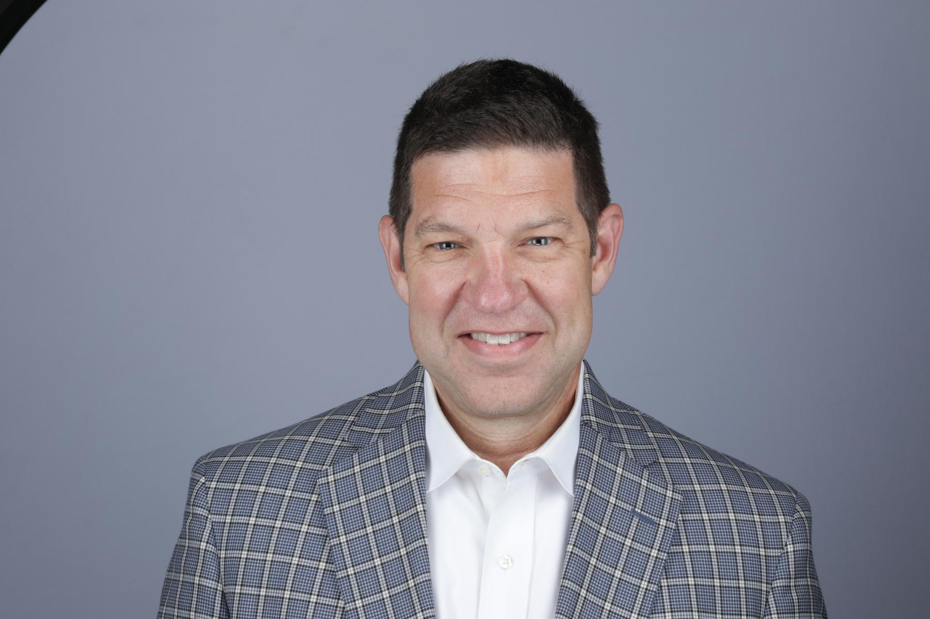
Questions ???
Glen Hall
ghall@ColtecConsulting.com
734-751-0791 mobile/text (Tulsa)

